Slide 1


INTRODUCTION
This project give a relationship between patient and doctor appointment

Slide 2


OBJECTIVES
The aim of this project is to analyze patient and doctor appointment data using SQL to extract valuable insights about appointment patterns, doctor performance, patient demographics, and overall healthcare efficiency

Slide 3
PROJECT OVERVIEW
Project:- Patient Doctor Appointment Analysis
This description outlines the objectives, key goals, methodology, and expected outcomes for the Patient Doctor
Conducted By
Rajesh Kushwah
Data Source

Slide 4


DATA SET
No. of Table
Table/s Name
TABLE NAME | ROW | COLUMNS
patienttable | 10 | 5
Doctortable | 3 | 5
Appointment | 10 | 6
PatientsAttendAppointments | 13 | 2
MedicalHistory | 10 | 6
Medication_Cost | 5 | 2
PatientsFillHistory | 10 | 3
No. Of Tables
Customers
Products
Categories
shippers

Slide 5
TOOLS
Like MSSQL, MS Power BI
Data Visualization & Dynamic Dashboard
Like MS Power Point
Presentation and Insights
Eg:MS Power Query Data Cleaning and Preparation
Eg: Power Pivot
Data modelling & Relationships
Eg: DAX
Calculated Columns & Measures

Slide 6


INSIGHTS

Slide 7
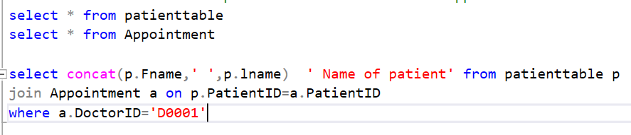
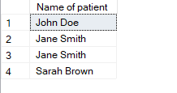
1.Find the names of patients who have attended appointments scheduled by Dr. John Doe.

Slide 8

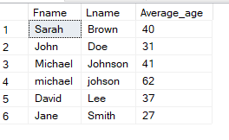
2 .Calculate the average age of all patients.

Slide 9
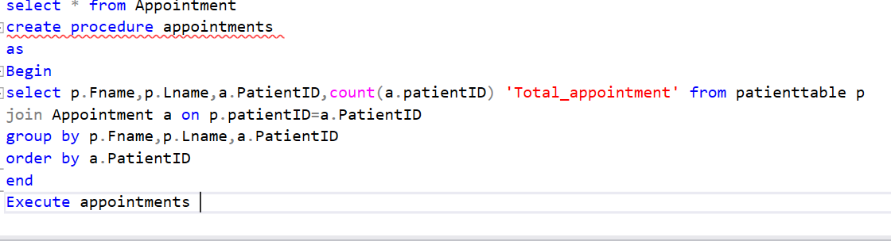
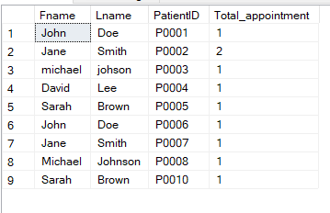
3.Create a stored procedure to get the total number of appointments for a given patient.

Slide 10
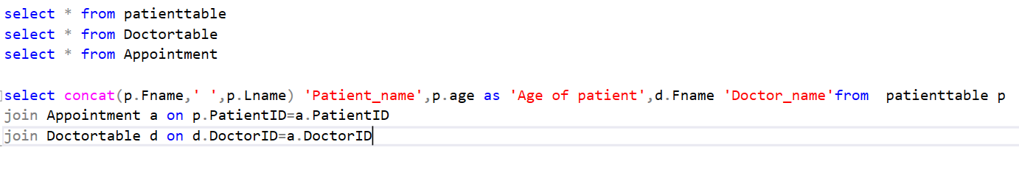
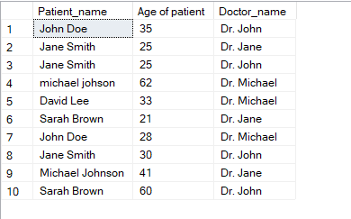
4.Find the names of patients along with their appointment details and the corresponding doctor's name

Slide 11
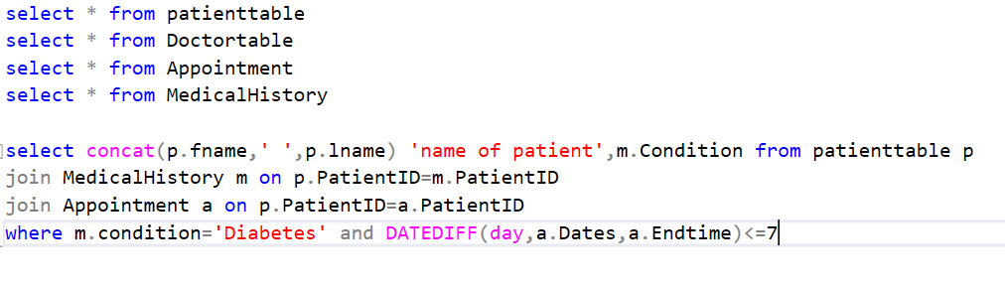
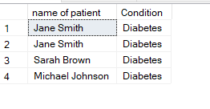
5.Find the patients who have a medical history of diabetes and their next appointment is scheduled within the next 7 days.

Slide 12
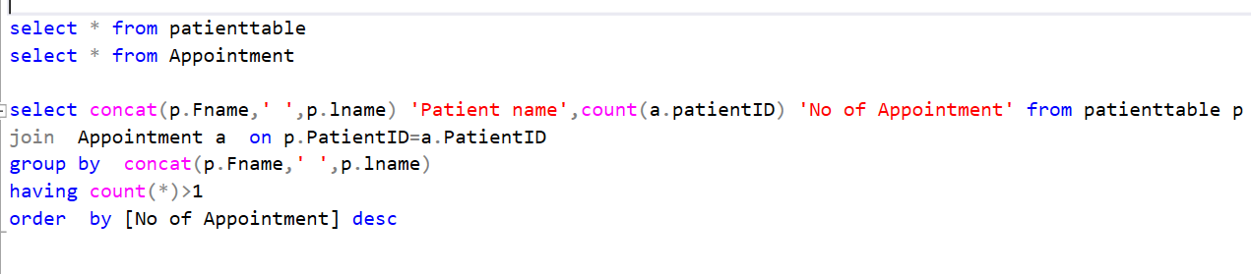
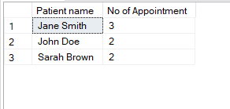
6.Find patients who have multiple appointments scheduled.

Slide 13
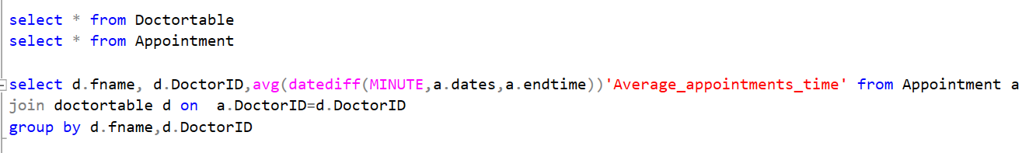
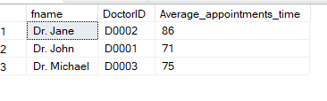
7.Calculate the average duration of appointments for each doctor.

Slide 14
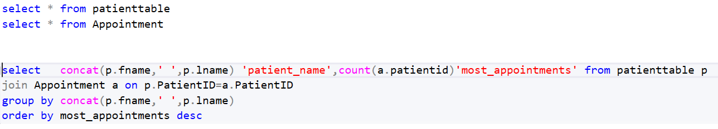
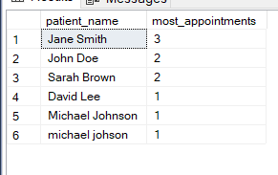
8. Find Patients with Most Appointments

Slide 15
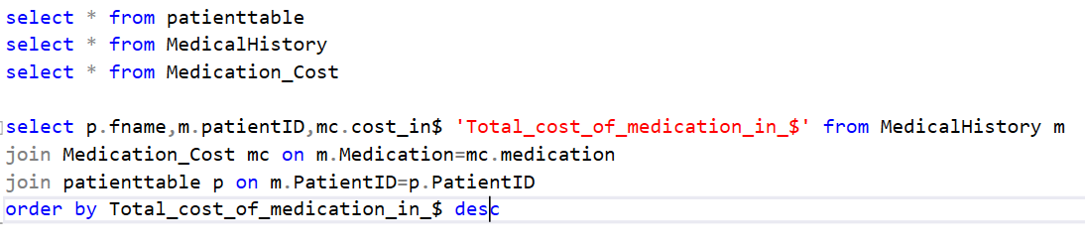
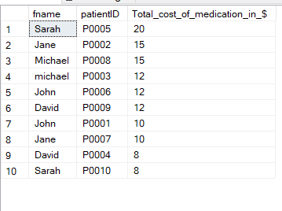
9 .Calculate the total cost of medication for each patient.

Slide 16

Our analysis 1.Only Three Person Have The Appointment By Dr.Hohn Joe . 2.The Maximum Patient Have Average Age Between 30 To 40. 3.Dr.John And Dr.Micheal Take The Maximum Appointment. 4.In This Data Set 4 Person Have Diabetes. 5.John Smith Have The Maximum 3 Appointment. 6.Dr.John Have Maximum Aappointment Duration Time .I.E 87 Mintes 7. Most Appointment Person Is John Smith.It Take 3 Appointment. 8.Sarah Patient Have Maximum Medical Cost I.E 20 $.

Slide 17

THANK YOU

